Slide 1
Hotel Management System Web-Based Application
260 Final Project Presentation Chris Glanzer, Riley Fitzpatrick, Kedar Neopaney
This presentation is empowered with Comic Sans

Slide 2
A Web-App?
Most appropriate given the nature of our project
ASP.NET seemed the best way to simplify distribution and user accessibility without sacrificing power or utility
Practical
Visual Studio Express 2015 assists a lot with database interaction, and given our lack of experience with SQL and database construction/management this helped accelerate development.
Familiarity
This project found an overlap with another class which we agreed was an excellent opportunity to apply our experiences from both.
This presentation is empowered with Comic Sans

Slide 3
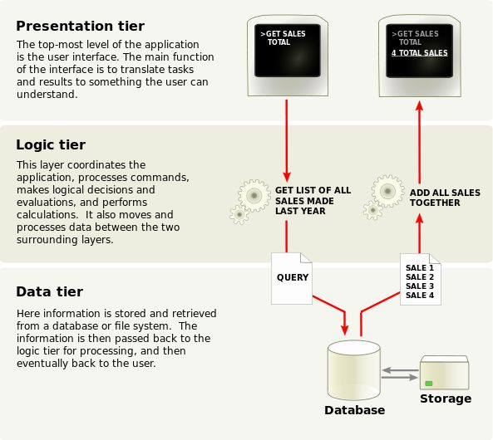
ASP.NET & Three Tier Architecture
Top Layer: Client-side (user interface)
Rule of least privelage – only give them access to what they need
Middle Layer: The code-behind (class files)
The server-side files that mediate what the user sees, and how they can interact with the bottom layer
Bottom Layer: SQL and Databases
Exactly what it sounds like
This presentation is empowered with Comic Sans

Slide 4
Demo Time
This presentation is empowered with Comic Sans

Slide 5
Post-Project Reflection
Challenges with the P
While Visual Studio helped with database interaction, it wasn’t the end-all be-all, we still had a good chunk to learn for those interactions
Exception handling and error pages…
Custom classes and objects VS. Built-in Classes and objects
This presentation is empowered with Comic Sans

